Slide 1
Planet Earth
Saving the world for future generations

Slide 2
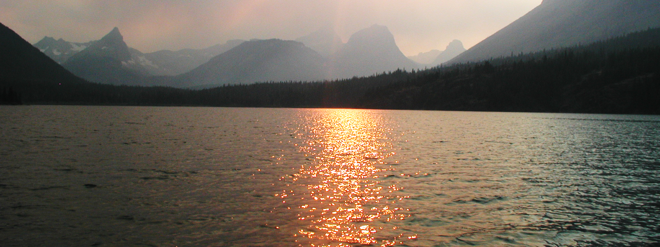
Preserving Planet Earth
We live on a mighty sphere of rock and water, sturdy enough to withstand intense battering by space debris over many millennia.
But our Earth may not be sturdy enough to withstand the damage we are causing with our reliance on fossil fuels. It is time to take a long, hard look at what we can do in this country to save the Earth.

Slide 3
The Gathering Storm
Recent events have endangered wildlife in our oceans and threatened habitats on land.

