Slide 1
Types of Consideration

Slide 2
Copyright and Terms of Service
Copyright © Texas Education Agency. The materials found on this website are copyrighted © and trademarked ™ as the property of the Texas Education Agency and may not be reproduced without the express written permission of the Texas Education Agency, except under the following conditions:
Texas public school districts, charter schools, and Education Service Centers may reproduce and use copies of the Materials and Related Materials for the districts’ and schools’ educational use without obtaining permission from the Texas Education Agency;
2) Residents of the state of Texas may reproduce and use copies of the Materials and Related Materials for individual personal use only without obtaining written permission of the Texas Education Agency;
3) Any portion reproduced must be reproduced in its entirety and remain unedited, unaltered and unchanged in any way;
4) No monetary charge can be made for the reproduced materials or any document containing them; however, a reasonable charge to cover only the cost of reproduction and distribution may be charged.
Private entities or persons located in Texas that are not Texas public school districts or Texas charter schools or any entity, whether public or private, educational or non-educational, located outside the state of Texas MUST obtain written approval from the Texas Education Agency and will be required to enter into a license agreement that may involve the payment of a licensing fee or a royalty fee.

Slide 3
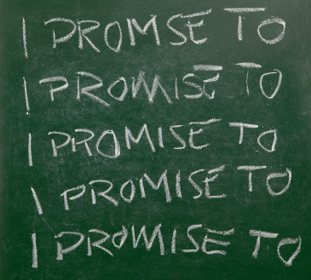
Consideration
…what a person demands and generally must receive in order to make her or his promise legally binding.
Notes:
Consideration is a key element for an enforceable contract.

Slide 4
Promise, Act, or Forbearance
Legal value in the underlying act that is promised
Forbearance - promise to not do something (must have legal value)
Notes:
Agreeing to stop doing something can be forbearance.

Slide 5
Contractual Exchanges
Promisor - person promising an action or forbearance
Promisee - the person to whom the promise is made
Consideration must be mutual
Notes:
The promisor and promisee must mutually agree to the consideration.

Slide 6
Legal Value
There has been a change in a party’s legal position as a result of the contract
Exchange of two benefits
Exchange of benefit for a detriment (forbearing of a legal right)
Exchange of two detriments
Notes:
When individuals become dependent upon an agreement or promise, there is legal value in the agreement. The exchange can range from two benefits to two detriments.

Slide 7
Adequacy of Consideration
What the parties give and get as consideration need not be of equal value.
Values that different people place on the same property may vary widely.
Economic value is unimportant as long as there is genuine agreement.
Nominal consideration can be as little as $1.
Notes:
A parent can transfer title of land to the child for as little as $1. This transaction will avoid inheritance taxes in the future.

Slide 8
Consideration vs. Gift
Gift - transfer of ownership without receiving anything in return
Promise to make a gift – generally not legally enforceable
Donor - person giving the gift
Donee - person receiving the gift
Donor - intentionally transfers the gift to the donee
Notes:
A gift is not consideration. A promise to give a gift is not enforceable by law.

Slide 9
Assignments
Independent Practice Assignments
Examine the following three case studies and determine the
outcome of each case as to the legality of each case:
1. Traveling the 48 After Graduation Case
2. Band Aid Case
3. Finder’s Keeper Case
Consideration PowerPoint Assignment: Ask students to create a PowerPoint presentation that defines consideration and the key terms in this lesson. The presentation should also give examples of binding consideration and actions that do not represent consideration. This project will be evaluated with the corresponding rubric.

